Slide 1

Unveiling Customer Patterns: A Data-Driven Approach to Reduce Churn
Leveraging Machine Learning to Enhance Customer Retention Strategies
Presented by: Analytical Aces

Slide 2
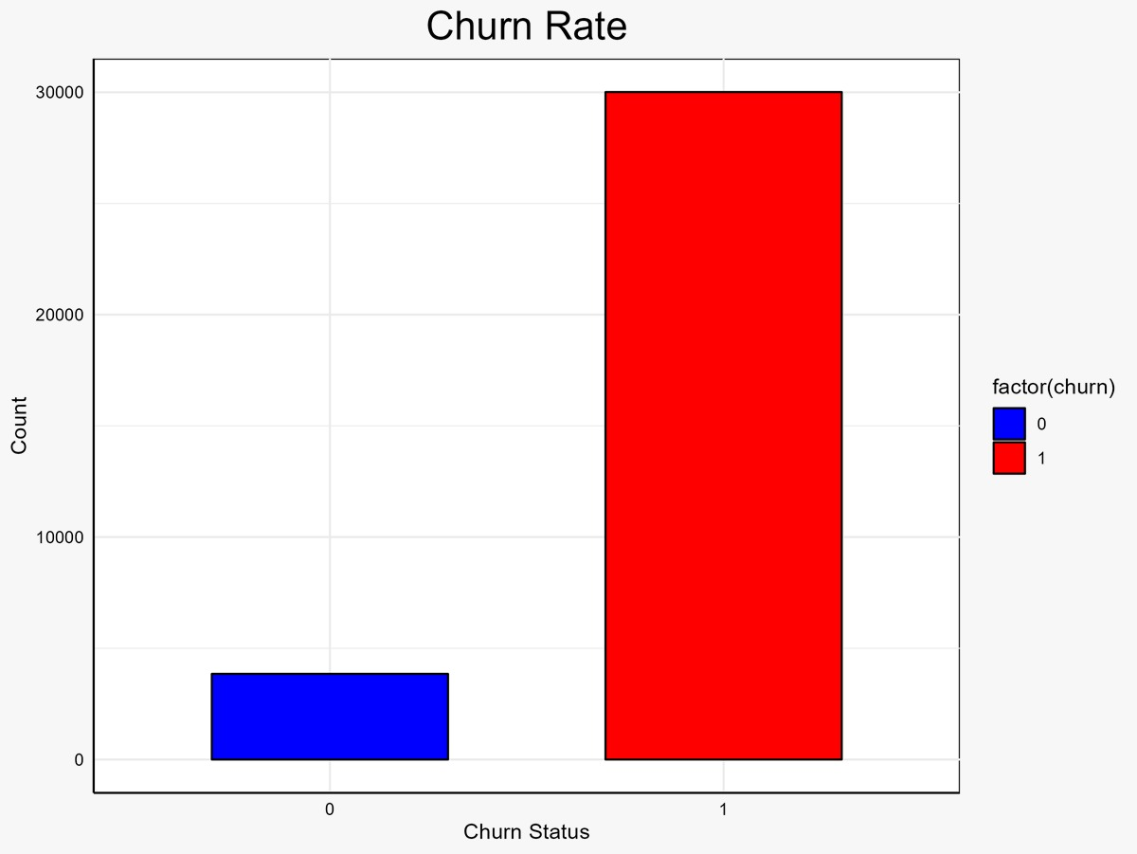
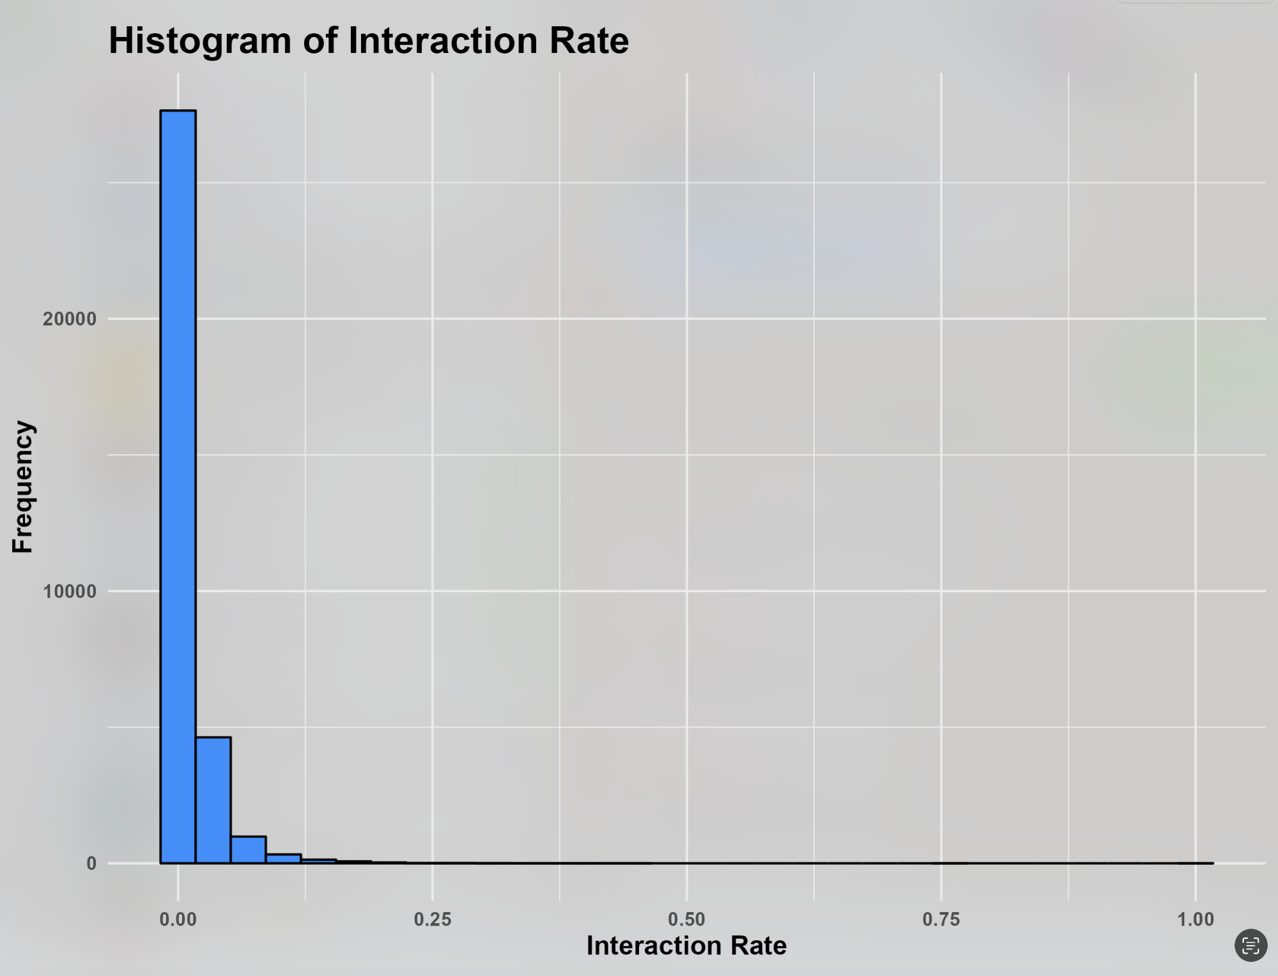
Unlocking Customer Loyalty: Insights from Churn Analysis
Aim: Commit to reversing the concerning 90% churn rate by applying data-driven insights, focusing squarely on boosting customer retention and establishing lasting loyalty.
Data Insight: Delving into a robust dataset reveals key patterns in customer online activities and purchasing behaviors, providing a solid base from which to develop and refine our retention strategies.
Churn Dynamics: With nearly 9 out of 10 customers not returning, identifying at-risk individuals is critical. Our data pinpoint moments when customers are likely to decide to leave, offering a window for strategic engagement to curb churn.
Customer Engagement: Data delineates clear inactivity periods preceding churn. Targeted, personalized marketing campaigns during these lulls can rekindle customer interest and prevent departure.
Visit Frequency: The observed decline in visit frequency underlines an urgent need for action. Initiatives like exclusive offers or loyalty rewards tailored to individual customer profiles can enhance engagement.
Revenue Impact: The data indicates that customers who churn contribute significantly less to overall revenue; converting these at-risk individuals into loyal patrons could result in a substantial boost to our financials.
Analytical Insights: Our correlation analysis and PCA have unveiled the possibility of capturing the essence of customer behavior with fewer, more impactful factors, suggesting a more focused and cost-effective approach to predictive modeling.
Inter-variable Relationship Analysis: Our in-depth analysis scrutinizes the interconnectedness of user behavior metrics, revealing that increased days of inactivity and lower visit frequency are precursors to customer churn. These findings underscore the intertwined nature of engagement metrics and churn, guiding our customer retention strategies.

Slide 3
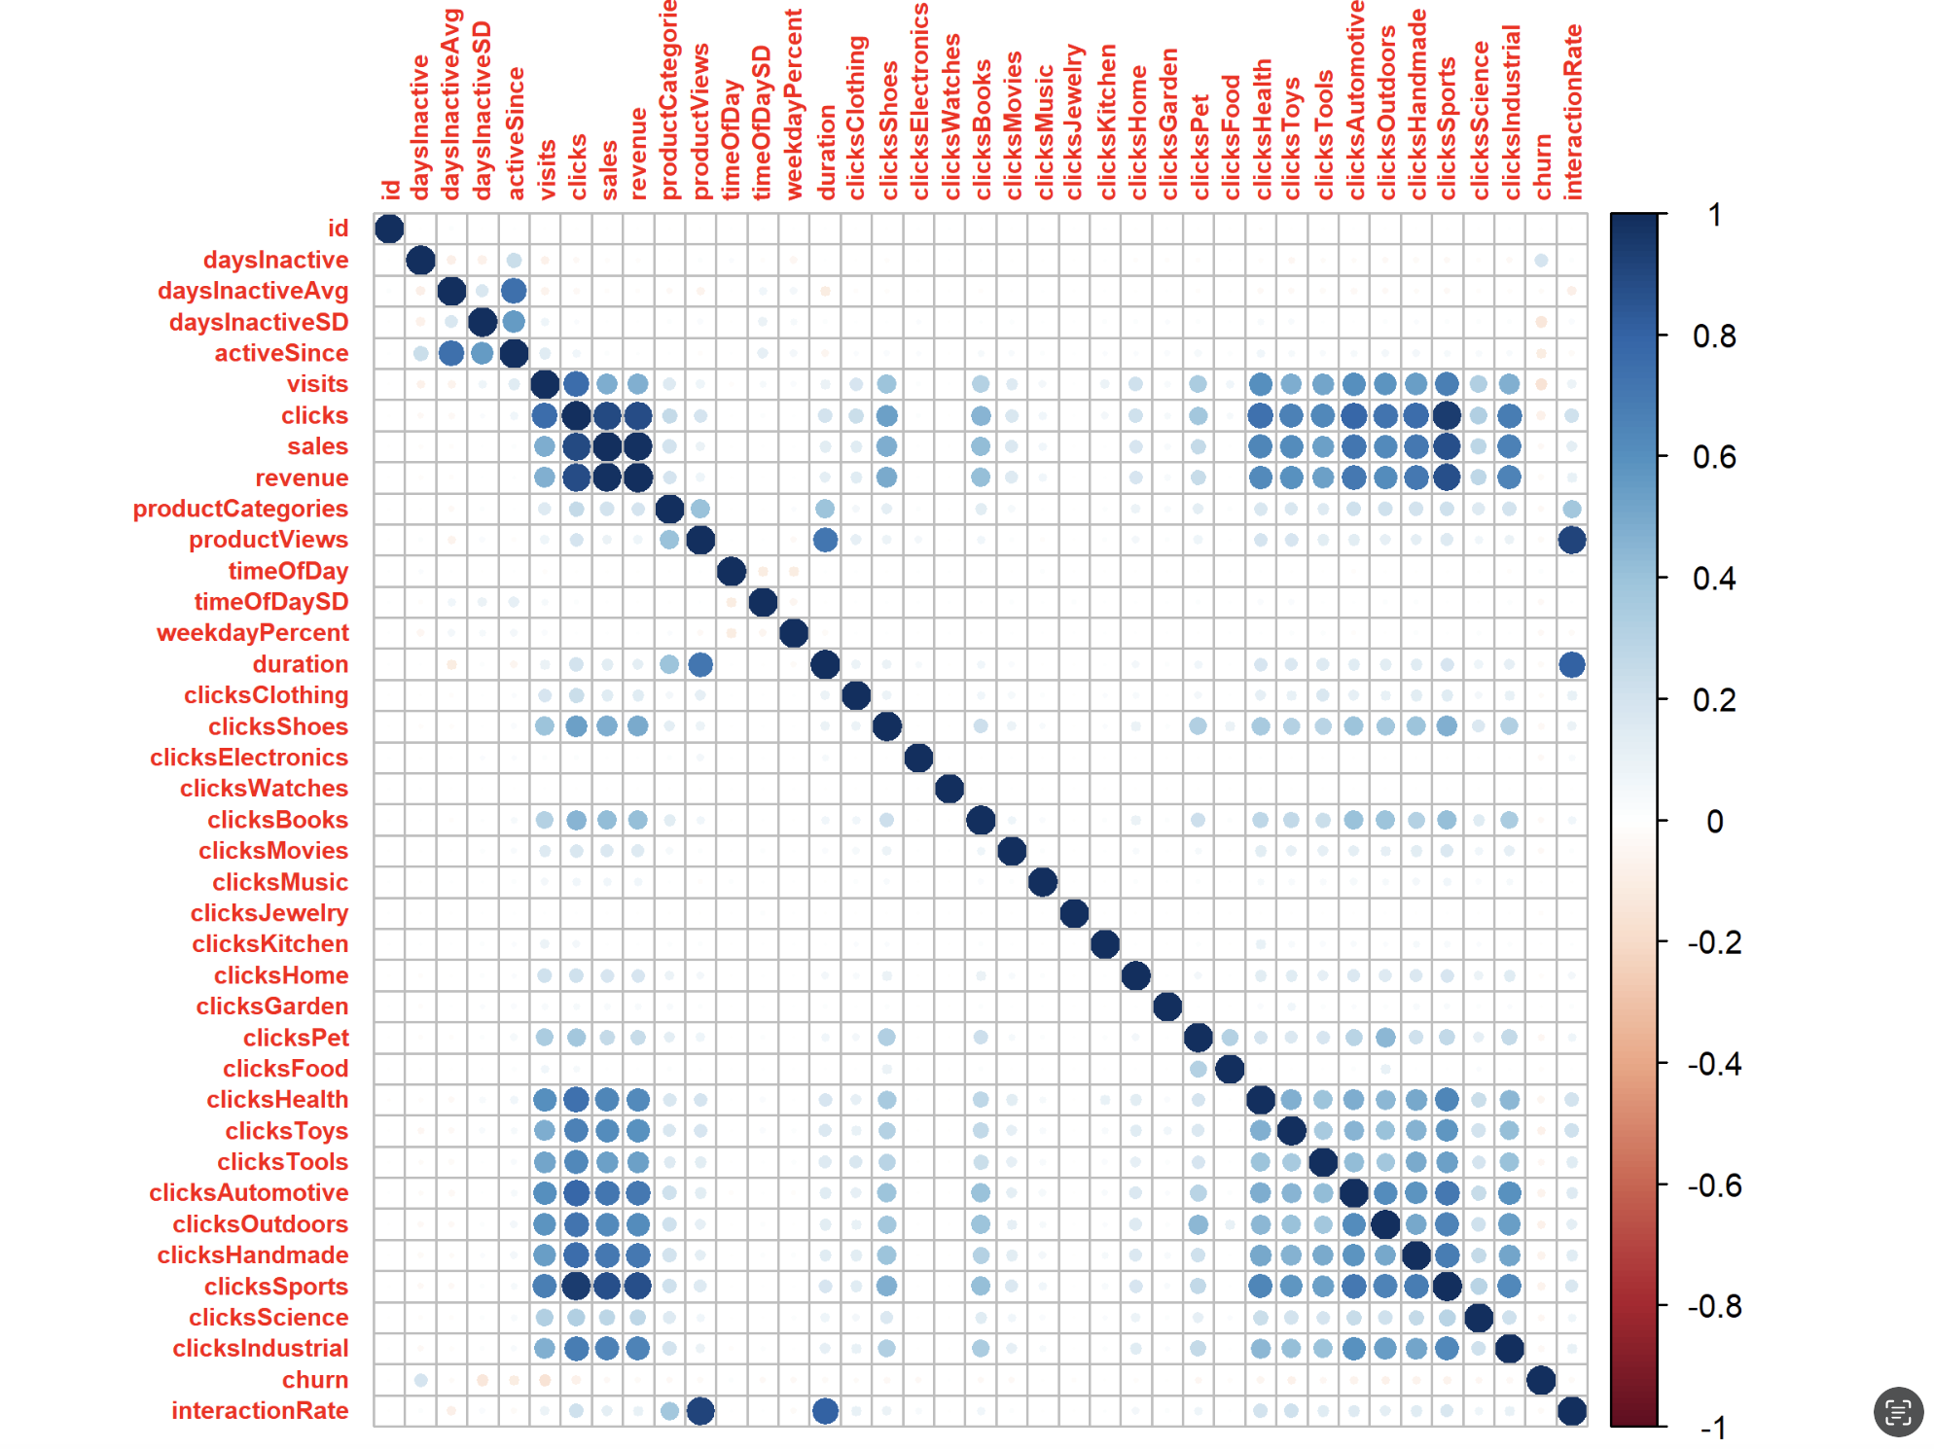
Precision Data Preparation
Comprehensive Feature Preservation: Ensured no detail was overlooked by keeping all features, providing a full spectrum analysis that enriches our understanding of customer behaviors and preferences.
Analytical Decisions for Model Integrity: Opted to include outliers and exclude PCA from our analysis, prioritizing data authenticity. This approach enhances model accuracy, ensuring our churn predictions truly reflect customer behaviors.
Missing Values: Ensured there are no missing values in the dataset.
Target Variable Transformation for Clarity: Converted 'churn' to a straightforward numeric format, simplifying model interpretation. This allows for clear, actionable insights into customer retention probabilities.
Novel Metric for Enhanced Engagement Insights: Developed 'interaction Rate', a key indicator of customer engagement per visit, empowering us to identify and enhance touchpoints critical for preventing churn.
Equitable Feature Consideration Through Data Scaling: Applied uniform scaling to essential features, ensuring each variable contributes fairly to our model. This step is crucial for identifying the most impactful drivers of churn.
Strategic Data Segmentation for Model Training: Divided our dataset with a strategic 75/25 split for training and validation, using stratified sampling to maintain consistency. This methodology is foundational for evaluating our model's performance and reliability.
Impact: These meticulous data preparation steps not only enhance the accuracy of our churn predictions but also equip us with a solid foundation to devise and implement effective customer retention strategies.
Next Steps: Armed with these insights, we are now poised to tackle customer churn with targeted interventions, setting the stage for improved customer loyalty and long-term business growth.

Slide 4
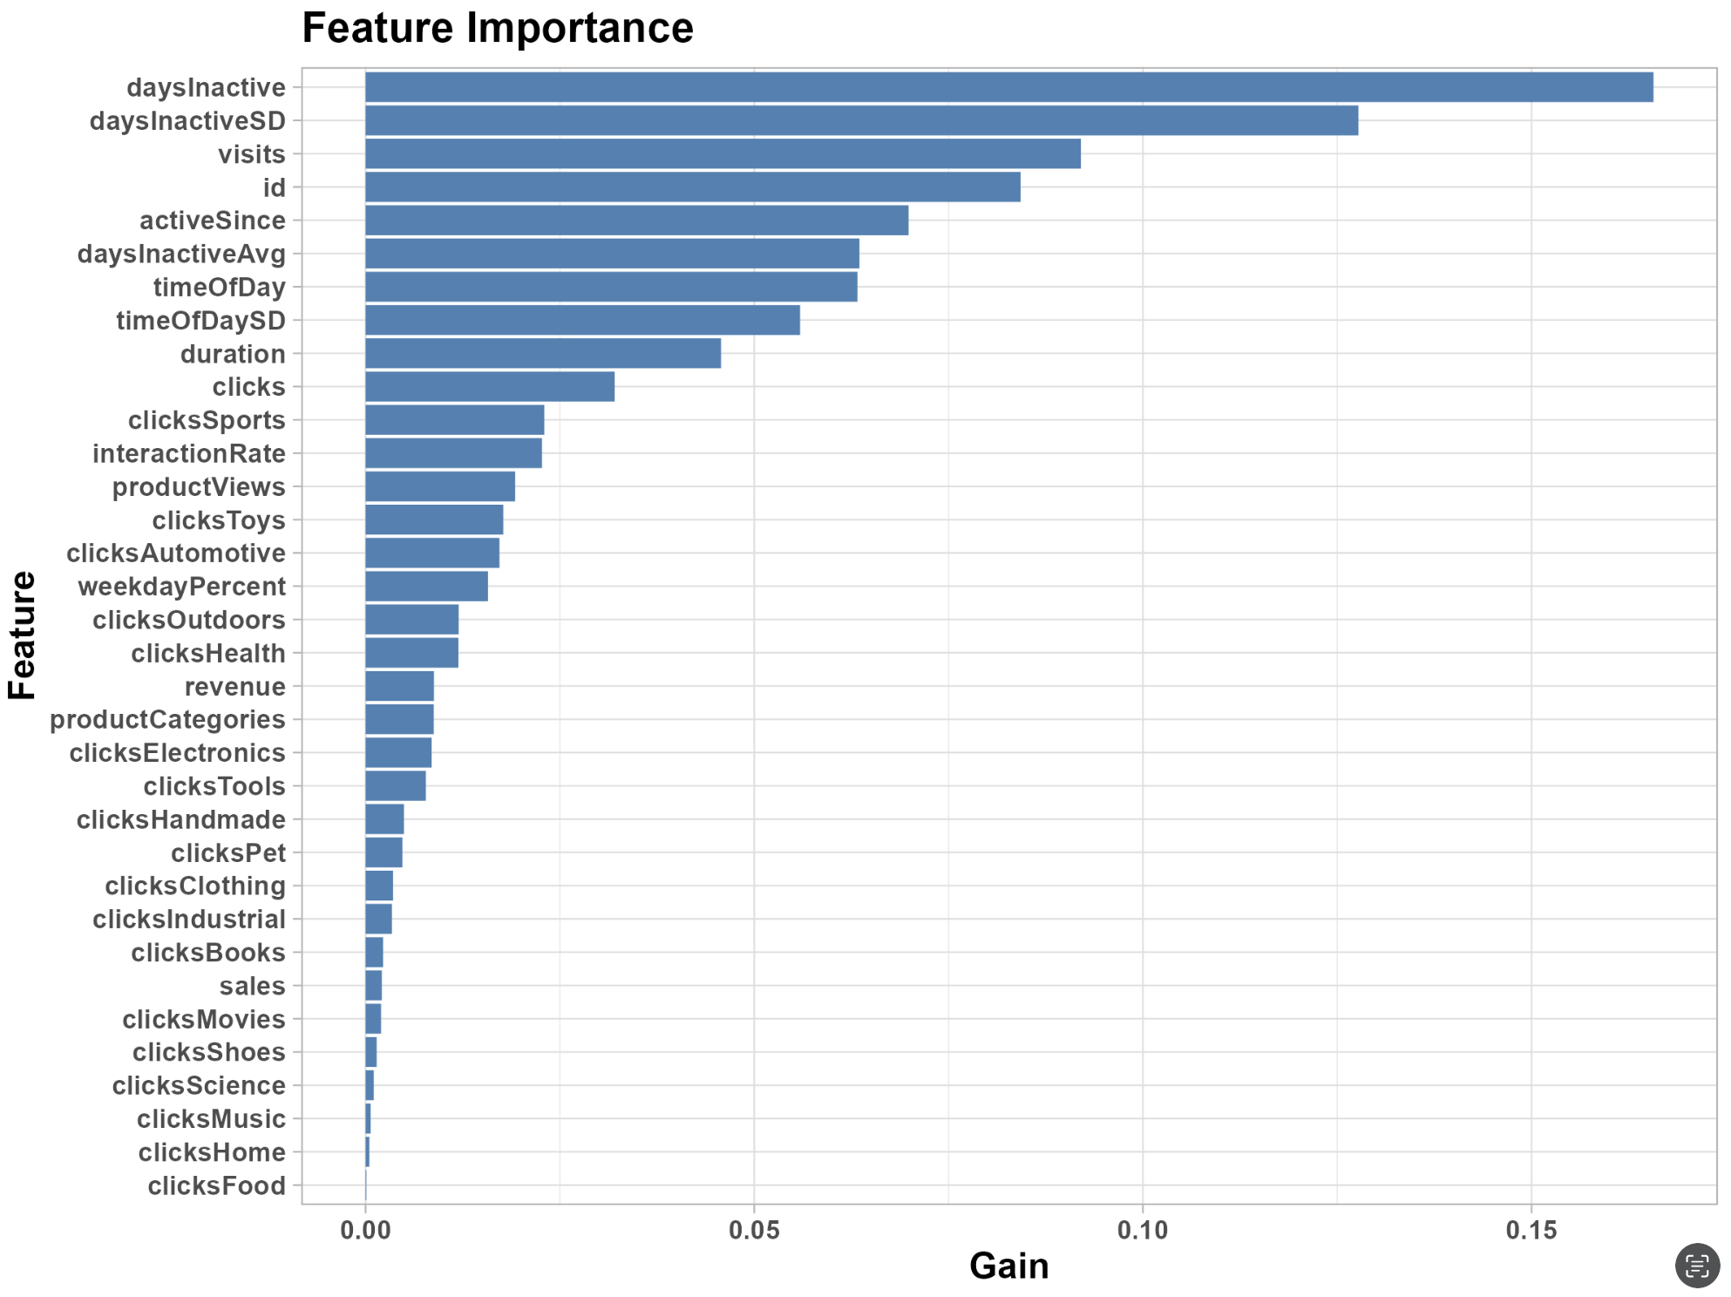
Advanced Modeling with XGBoost
Model Selection:
XGBoost: Adopting XGBoost for churn prediction not only aligns with cutting-edge analytical techniques but also significantly enhances our strategic toolkit. By identifying at-risk customers with high precision, we can deploy targeted retention strategies more effectively, ensuring a proactive stance towards customer loyalty.
Model Preparation: Precise Data Transformation
Target Encoding: Converted 'churn' in the validation dataset to a numeric format, aligning with model requirements for accurate performance evaluation.
Feature Matrix Creation: Constructed matrices from training data, excluding the 'churn' column, ensuring that the model could learn from all relevant predictors without bias.
Model Configuration: Tailored XGBoost Parameters
Objective: Utilized binary: logistic for direct applicability to our churn prediction goal, focusing on binary outcomes for robust churn identification.
Evaluation Metric: Prioritized AUC to assess the model's ability to differentiate between churners and non-churners, optimizing for true positive rates while minimizing false positives.
Optimization Settings: Carefully selected hyperparameters such as eta, max_depth, and subsample rates to fine-tune the model's learning process and structure, enhancing its predictive accuracy.
Training Process: Leveraging XGBoost's Strengths
Data Input: Fed the prepared feature matrix and labels into XGBoost, utilizing a DMatrix for efficient storage and speed.
Iterative Learning: Conducted training over 100 rounds, adjusting for model complexity and training depth to capture nuanced patterns in customer behavior.

Slide 5
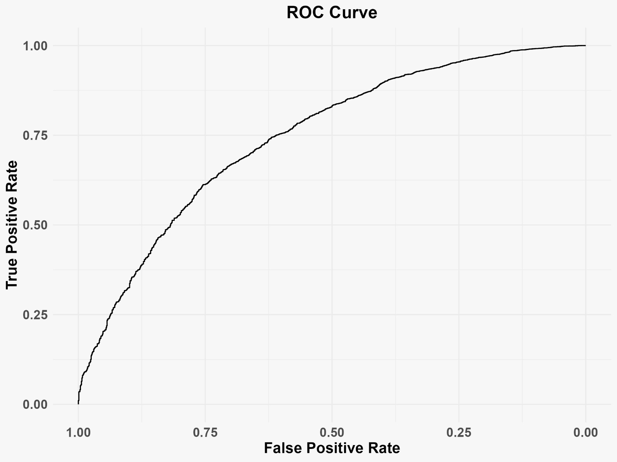
Model Evaluation
Model Validation Procedure
Validation Dataset Transformation: Prepared the validation dataset in a format compatible with XGBoost, ensuring a fair evaluation of the model's predictive capabilities.
Predictive Accuracy Assessment: Employed the ROC curve and AUC score as primary metrics for evaluating model performance, focusing on the model's ability to distinguish between churners and non-churners accurately.
Key Findings
Validation AUC Score: Achieved 75% AUC score on the validation set, underscoring the model's effectiveness in predicting customer churn with a high degree of accuracy.
Model Refinement and Benchmarking
Iterative Optimization: Utilized validation feedback to fine-tune the model, enhancing its predictive precision through careful adjustments to features and hyperparameters.
Strategic Benchmarking: Positioned the model's performance against historical benchmarks and industry standards, demonstrating significant improvements and setting new excellence benchmarks.
Submission Process:
Operationalizing Insights: Transitioned from model validation to action, preparing churn predictions for new or unseen data and submitting results, showcasing the model's readiness for practical application.
Evaluation Replicability: Detailed code for model evaluation is included with the report, ensuring transparent and independently verifiable methodology.
Model | Validation Set Accuracy
K Nearest Neighbors (KNN) | 68.1%
Decision Trees | 65.2%
Logistic Regression | 74%
XGBoost | 75.6%
Random Forest | 70.4%
Support Vector Classifier | 71.3%
Naïve Bayes | 52.5%

Slide 6
Strategic Actions for Enhancing Customer Loyalty
Key Predictive Indicators of Churn: Inactivity as a Leading Churn Predictor: Extended periods of inactivity are the primary indicators of churn. Proactive re-engagement at the first sign of reduced activity is vital.
Engagement Regularity: Consistent engagement patterns are less likely to lead to churn, emphasizing the need for a steady, interactive customer relationship.
Managerial Recommendations: Customer Experience Enhancement: Invest in a seamless and engaging online platform to foster frequent customer visits and interactions, directly impacting the churn indicators.
Predictive Analytics Integration: Embed churn prediction analytics within CRM systems to anticipate and mitigate churn risks through targeted customer interventions.
Proactive Retention Initiatives: Engagement Monitoring: Develop systems for real-time tracking of engagement levels, enabling early detection and intervention for customers at risk of churning.
Customized Re-engagement Strategies: Deploy personalized re-engagement campaigns, utilizing customer behavior insights to offer relevant and timely incentives.
Limitations and Forward Planning: Model Scope and Data Depth: Acknowledge the limitations of the model due to dataset depth and scope. Future models should incorporate broader behavioral datasets for enhanced accuracy.
Continuous Model Evolution: Commit to regular updates and refinements of the model, incorporating the latest customer data and feedback for sustained relevance.
Executive Action Points: Invest in a Dynamic CRM: Allocate resources to develop a CRM that not only utilizes analytics but also evolves with the changing consumer landscape.
Tailor Customer Journey Maps: Customize the online user journey based on predictive analytics to create personalized paths that reduce churn likelihood.
Strengthen Customer Support: Enhance support channels to address issues promptly, improving satisfaction and reducing churn triggers.

